Slide 1
GeoData WS2022/23 Group B
Matsvei Yankouski, 30829 Stas Besliu, 30873 Lorena García, 32052
(presentation: 7 mins max. / person + 5 mins discussion / group)

Slide 2
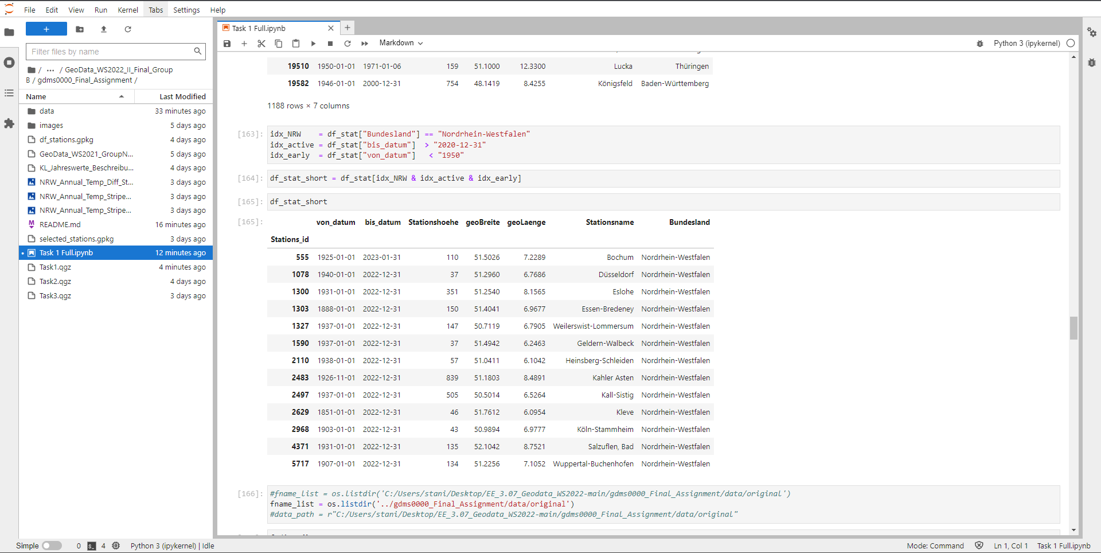
1. Warming Stripes

Slide 3
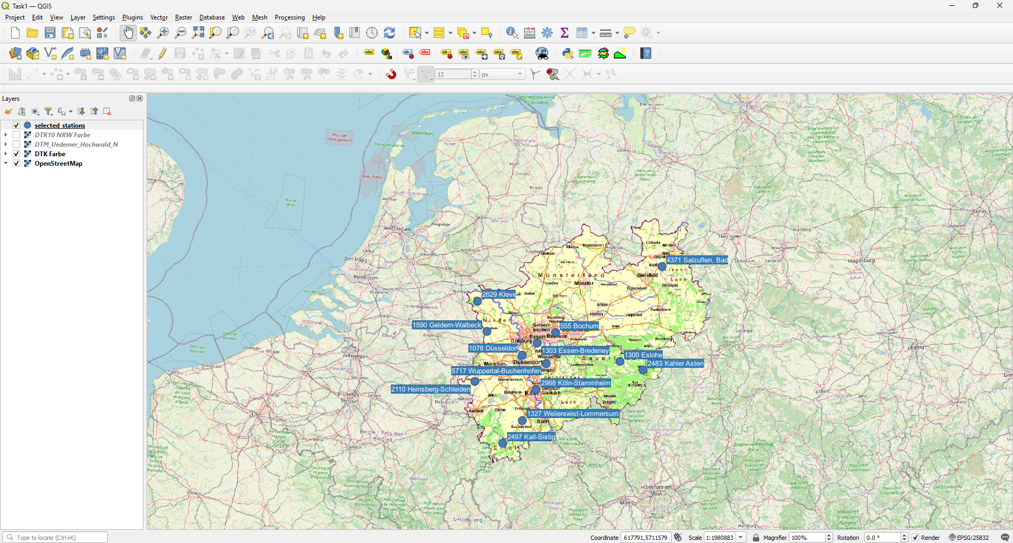
1. Warming Stripes

Slide 4
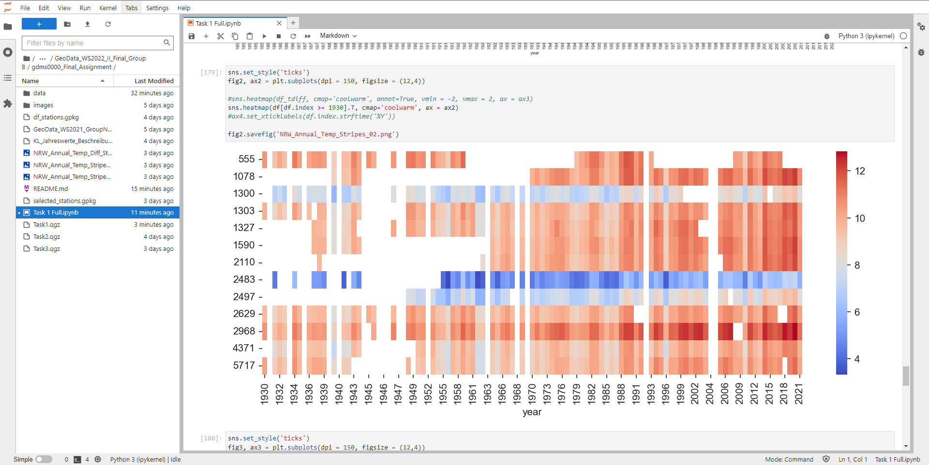
1. Warming Stripes

Slide 5
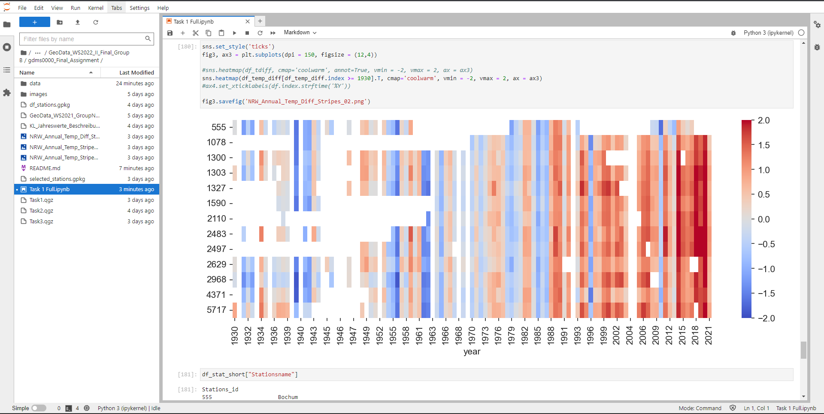
1. Warming Stripes

Slide 6
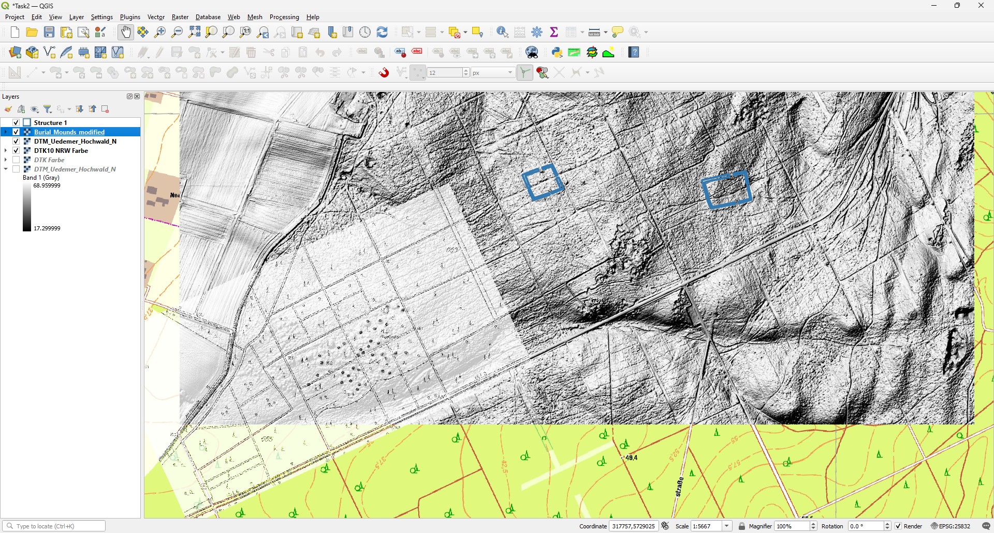
2. Digitization: Burial Mounds in Uedemer Hochwald

Slide 7
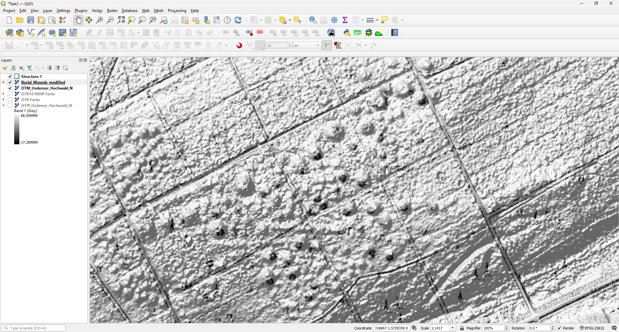
2. Digitization: Burial Mounds in Uedemer Hochwald

Slide 8
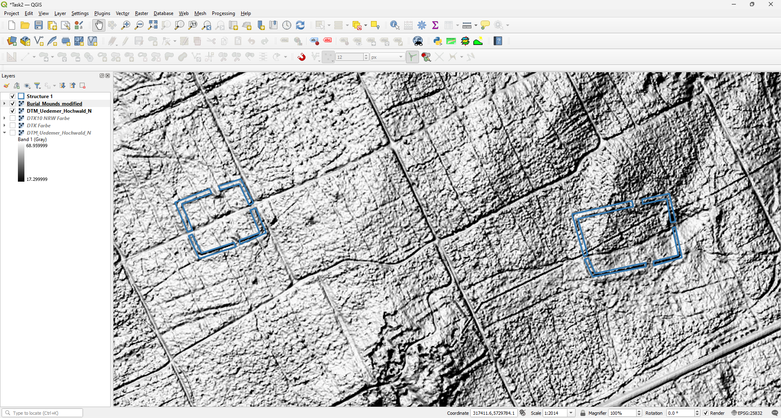
2. Digitization: Burial Mounds in Uedemer Hochwald

Slide 9
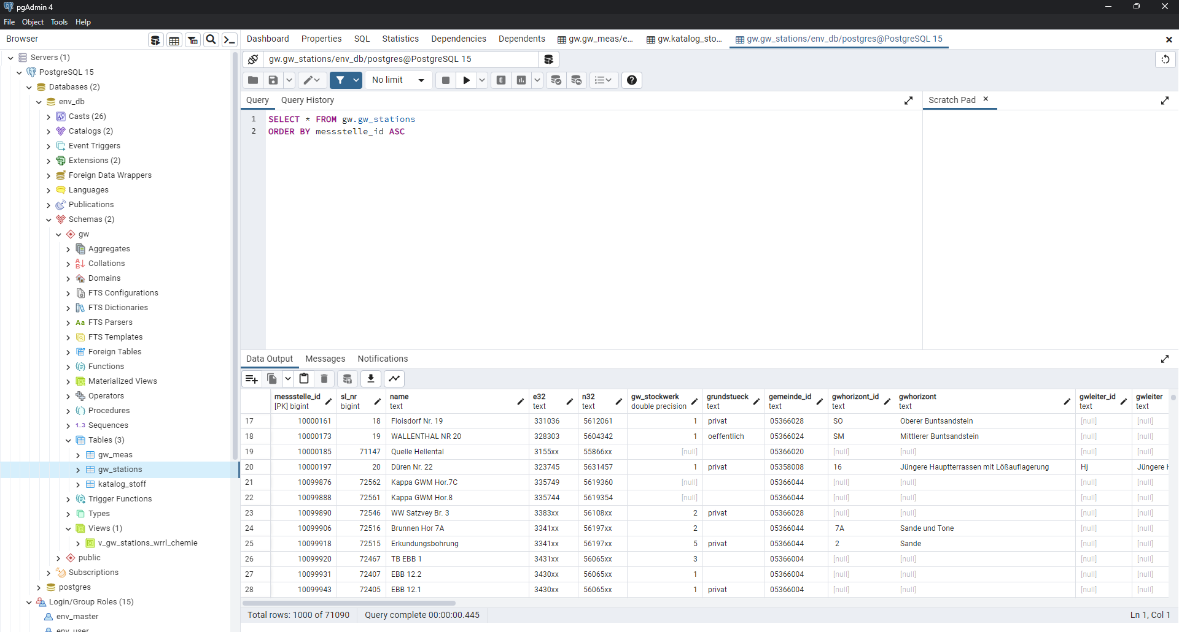
3. OpenHygrisC Nitrate Data: Create a Movie with the QGIS Temporal Controller Connected to PostgreSQL / PostGIS

Slide 10
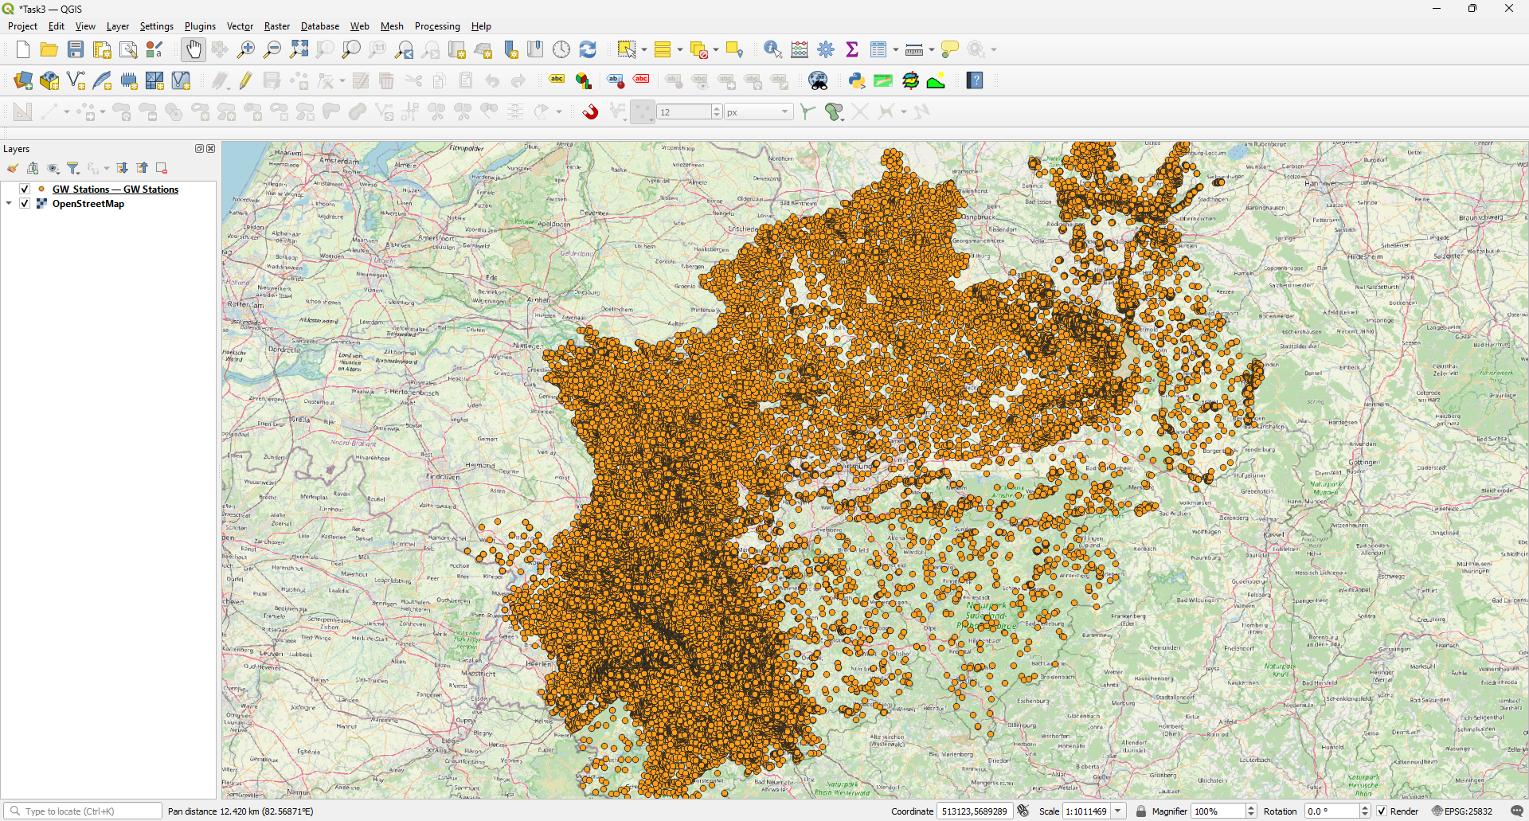
3. OpenHygrisC Nitrate Data: Create a Movie with the QGIS Temporal Controller Connected to PostgreSQL / PostGIS

Slide 11
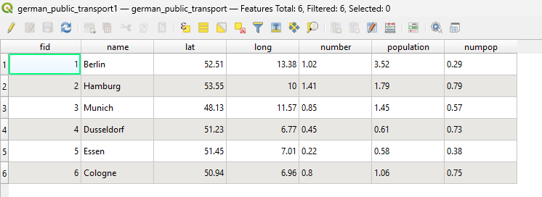
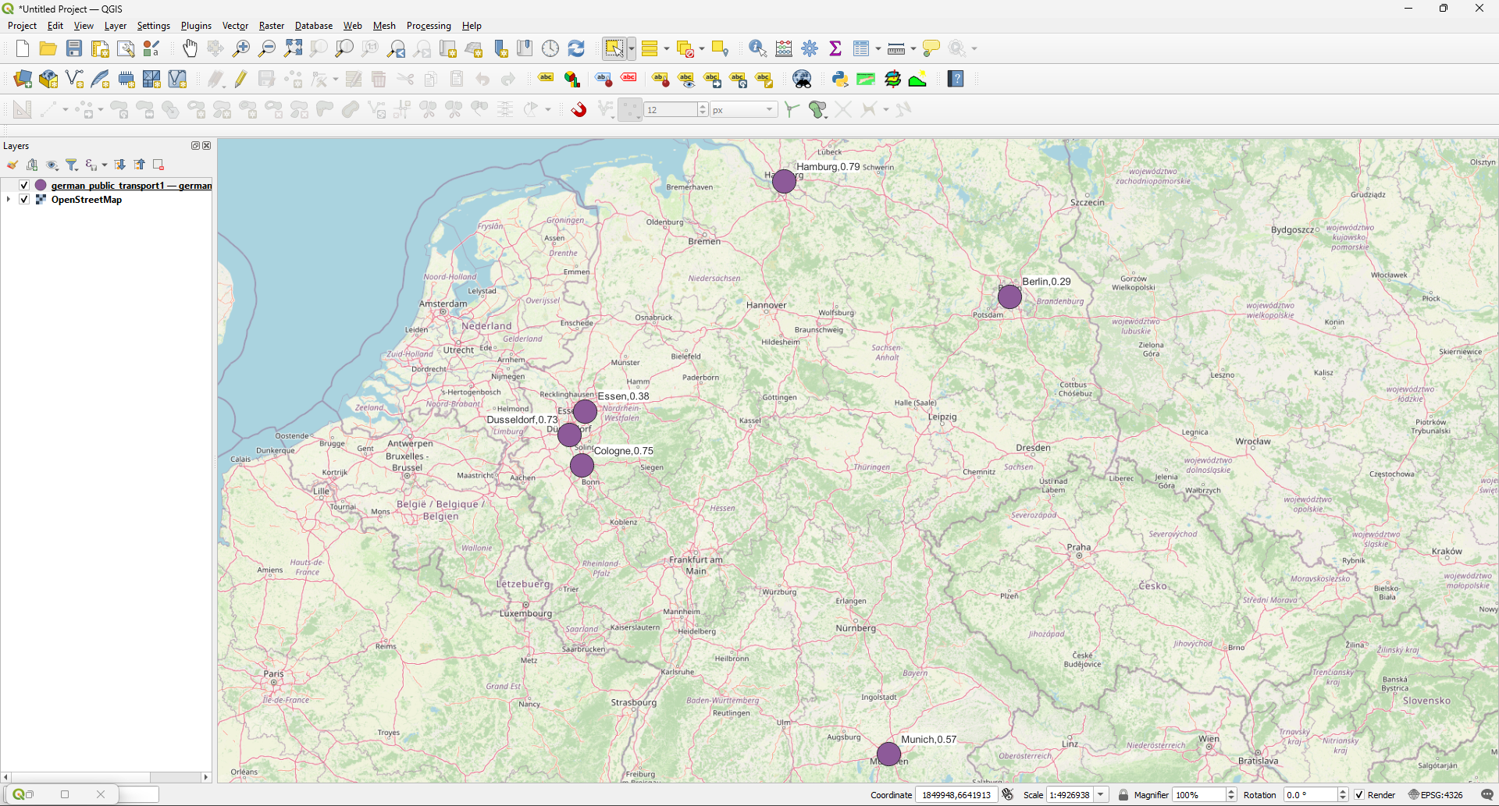
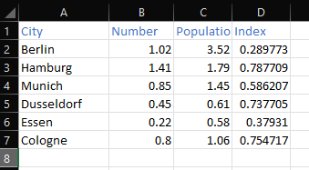
4. Public transport analysis in major german cities

Slide 12
30829: Your Personal View
Biggest challenges?
SQL databases engineering, Connection between servers and importing files to servers. Also, new libraries for working with geodata in python.
Lessons learned?
SQL coding, connections between local folders and servers. Engineering with QGIS and Geodata engineering in general.
Whatever you want to say related to course?
The course was interesting and hard at the same time. I have never used these packages and never worked with QGIS, but I think now because of this course I really upgraded my skills in python, database engineering and QGIS. Also, we can clearly see the effort from our professor in preparing different activities and interesting tasks for students. I want to thank him for this effort and for plenty of online resourses to work with (and for the recordings of lectures!!!)

Slide 13
30829: Self-Assessment, Part 1 (give short answers)
What is your role in the group?
python_master☺
Which (sub)tasks are you responsible for?
I worked under all tasks, but my main fields were coding and databases.
With whom have you been cooperating?
With qgis_master (Stas Besliu)

Slide 14
30829: Self-Assessment, Part 2 (On a scale from 1 (poor) to 5 (very good))
What is your personal knowledge gain?
5
How do you rate your commitment?
5
How difficult is your task?
4

Slide 15
30873: Your Personal View
Biggest challenges?
Connecting the database to QGIS, 50/50 was the temporal controler.
Lessons learned?
What databases are and how to manage them, new python libraries.
Whatever you want to say related to course:
Appreciate the dedication regarding the variety of the task(nowadays topics and real-world application). Thanks for the input and for all the effort and material uploaded online.

Slide 16
30873: Self-Assessment, Part 1 (give short answers)
What is your role in the group?
qgis_master☺
Which (sub)tasks are you responsible for?
I worked under all tasks, but my main fields were qgis, databases.
With whom have you been cooperating?
python_master (Matsvei Yankouski)

Slide 17
30873: Self-Assessment, Part 2 (On a scale from 1 (poor) to 5 (very good))
What is your personal knowledge gain?
5
How do you rate your commitment?
5
How difficult is your task?
3

Slide 18
32052: Your Personal View
Biggest challenges?
Use the DTM and measure the typical mound heights relative to their direct environment/neighborhood.
Lessons learned?
How to work on hillshade model in direction East-North-East of the burial mounds area and search for weakly visible reectangular structures which are not paths.
Whatever you want to say related to course, …
Grateful for the way to impart this subject and teach us this software packages that will clearly serve us well in the future.

Slide 19
32052: Self-Assessment, Part 1 (give short answers)
What is your role in the group?
I cannot say that I am a master of any software source, but I did everything I could to support my team and contribute my knowledge when carrying out the tasks
Which (sub)tasks are you responsible for?
Try to support as much as I could my team and produce the presentation
With whom have you been cooperating?
With qgis_master (Stas Besliu) and pyton_master (Matsvei Yankouski)

Slide 20
32052: Self-Assessment, Part 2 (On a scale from 1 (poor) to 5 (very good))
What is your personal knowledge gain?
5
How do you rate your commitment?
3
How difficult is your task?
2

